Slide 1
Chapter 7
E-commerce Marketing and Advertising Concepts
Copyright © 2014 Pearson Education, Inc. Publishing as Prentice Hall

Slide 2
The Internet Audience
Around 70% (85 million) U.S. households have broadband Internet access in 2013
Growth rate has slowed
Intensity and scope of use both increasing
Some demographic groups have much higher percentages of online usage than others
  Income, education, age, ethnic dimensions
Copyright © 2014 Pearson Education, Inc. Publishing as Prentice Hall
Slide 6-<number>

Slide 3
Community Effects
Traditional stores:
  Location, location, location
Online stores:
  Location has almost no effects since shipping services can solve everything
  Neighborhoods:
    How people around purchase
    Huge effect on new products
    Less effect on already well-known products
Copyright © 2014 Pearson Education, Inc. Publishing as Prentice Hall
Slide 6-<number>

Slide 4
Consumer Behavior
Study of consumer behavior
  Attempts to explain what consumers purchase and where, when, how much, and why they buy
Consumer behavior models
  Attempt to predict or explain wide range of consumer decisions
  Based on background demographic factors and other intervening, more immediate variables
Profiles of Online Consumers (See Table 6.2)
  Consumers shop online primarily for convenience
Copyright © 2014 Pearson Education, Inc. Publishing as Prentice Hall
Slide 6-<number>

Slide 5
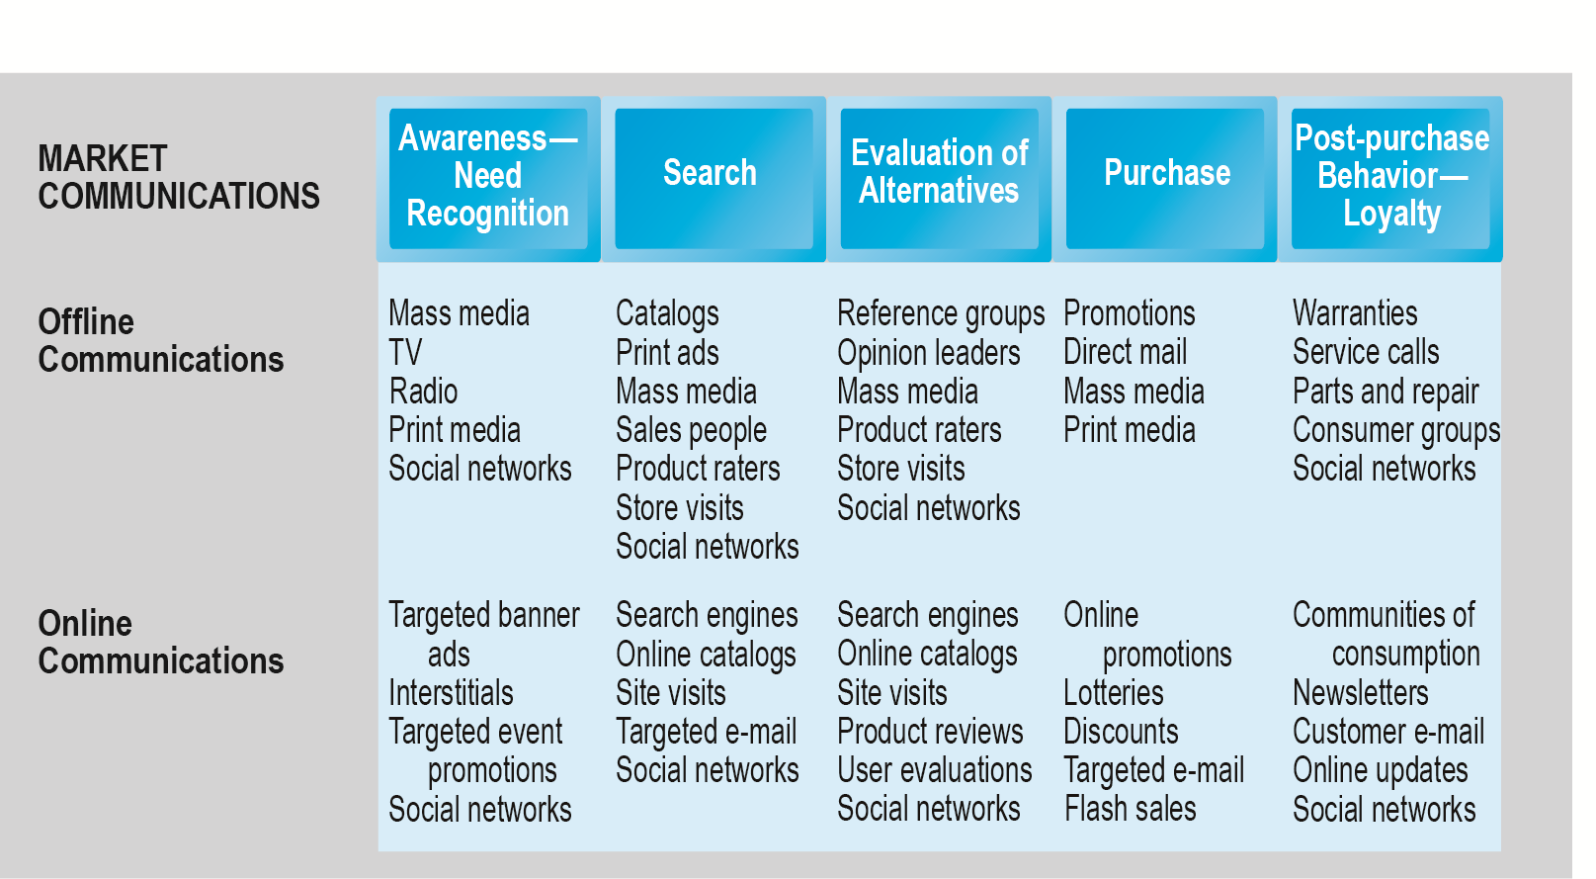
The Consumer Decision Process and
Supporting Communications
Figure 6.2, Page 334
Copyright © 2014 Pearson Education, Inc. Publishing as Prentice Hall
Slide 6-<number>

Slide 6
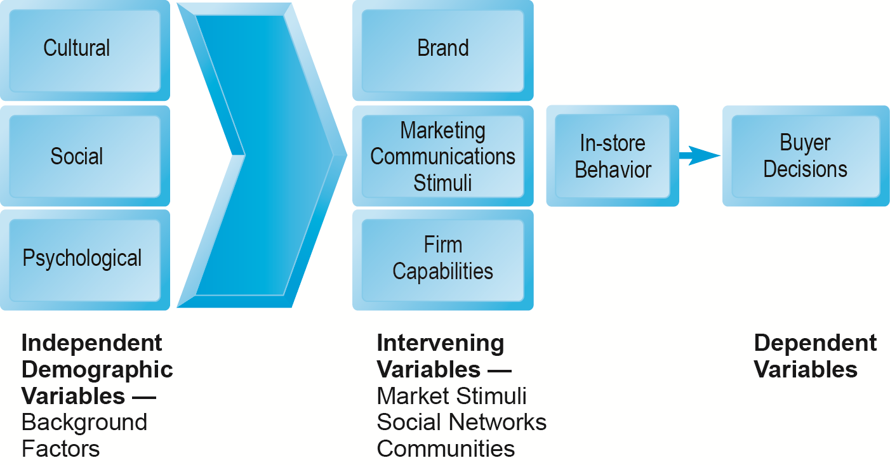
A General Model of Consumer Behavior
Figure 6.1, Page 333
SOURCE: Adapted from Kotler and Armstrong, 2009.
Copyright © 2014 Pearson Education, Inc. Publishing as Prentice Hall
Slide 6-<number>

Slide 7
The Online Purchasing Decision
Five stages in consumer decision process
  Awareness of need
  Search for more information
  Evaluation of alternatives
  Actual purchase decision
  Post-purchase contact with firm
Copyright © 2014 Pearson Education, Inc. Publishing as Prentice Hall
Slide 6-<number>

Slide 8
Shoppers: Browsers and Buyers
Shoppers: 89% of Internet users
  73% buyers
  16% browsers (purchase offline)
One-third of offline retail purchases influenced by online activities
Online traffic also influenced by offline brands and shopping
E-commerce and traditional commerce are coupled: Part of a continuum of consumer behavior
Copyright © 2014 Pearson Education, Inc. Publishing as Prentice Hall
Slide 6-<number>

Slide 9
What Consumers Shop for and
Buy Online
Big ticket items ($1000 or more)
  Travel, computer hardware, electronics
  Consumers now more confident in purchasing costlier items
Small ticket items ($100 or less)
  Apparel, books, office supplies, software, and so on
Types of purchases depend on level of experience with the Web
Copyright © 2014 Pearson Education, Inc. Publishing as Prentice Hall
Slide 6-<number>

Slide 10
How Consumers Shop
How shoppers find online vendors
  Search engines
  Marketplaces (Amazon, eBay)
  Specific retail site
27% of Internet users don’t shop online
  Trust factor
  Hassle factors (shipping costs, returns, etc.)
Copyright © 2014 Pearson Education, Inc. Publishing as Prentice Hall
Slide 6-<number>

Slide 11
Multi-Channel Marketing Plan
Web site
Traditional online marketing
  Search engine, display, e-mail, affiliate
Social marketing
  Social networks, blogs, video, game
Mobile marketing
  Mobile/tablet sites, apps
Offline marketing
  Television, radio, newspapers
Copyright © 2014 Pearson Education, Inc. Publishing as Prentice Hall
Slide 6-<number>

Slide 12
Traditional Online Marketing and Advertising Tools
Search engine marketing and advertising
Display ad marketing
E-mail marketing
Affiliate marketing
Viral marketing
Lead generation marketing
Social, mobile, and local marketing and advertising
Copyright © 2014 Pearson Education, Inc. Publishing as Prentice Hall
Slide 6-<number>

Slide 13
Search Engine Marketing and Advertising
Search engine marketing (SEM)
  Use of search engines for branding
Search engine advertising
  Use of search engines to support direct sales
Types of search engine advertising
  Sponsored links (keyword paid inclusion)
  Keyword advertising (purchase key words by bidding at search sites)
  Network keyword advertising (Publs join networks and allow search engine ads to be place on their site for a fee)
Copyright © 2014 Pearson Education, Inc. Publishing as Prentice Hall
Slide 6-<number>

Slide 14
Search Engine Marketing (cont.)
Search engine optimization process of improving ranking of web pages with search engines
Social search
  Utilizes social graph (friend’s recommendations, past Web visits, Facebook Likes, Google +1’s) to provide fewer and more relevant results
Search engine issues
  Paid inclusion and placement practices
  Link farms
  Content farms
  Click fraud
Copyright © 2014 Pearson Education, Inc. Publishing as Prentice Hall
Slide 6-<number>

Slide 15
Search Engine Marketing (cont.)
Search engine issues
  Link farms are websites that link to one another
  Content farms are companies that generate volumes of textual content for multiple website to attract viewers and search engines
    They profit by attracting large numbers of readers and exposing them to ads
  Click fraud occurs on the Internet in pay-per-click (PPC) online advertising when a competitor clicks on a search engine ads forcing the advertiser to pay for the click even when it is not legitimate.
    The process could be automated costing advertisers lots of money
Copyright © 2014 Pearson Education, Inc. Publishing as Prentice Hall
Slide 6-<number>

Slide 16
Display Ad Marketing
Banner ads take customers to advertiser web site
Rich media ads employ animation & sound
Video ads
Sponsorships ads (sponsoring an event)
Advertising networks help companies take advantage of internet marketing/advertising
Advertising exchanges and real-time bidding facilitate booking available ad slots across ad networks
Copyright © 2014 Pearson Education, Inc. Publishing as Prentice Hall
Slide 6-<number>

Slide 17
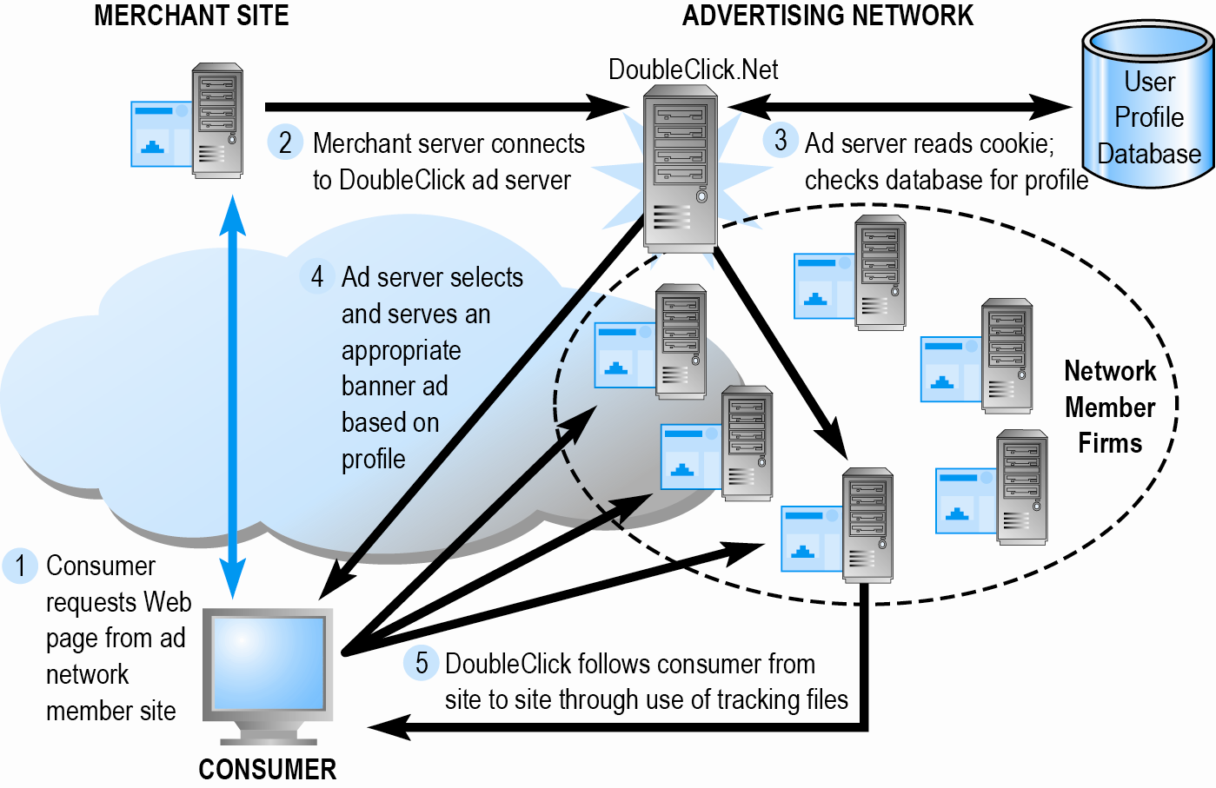
How an Advertising Network
Such as DoubleClick Works
Figure 6.7, Page 352
Copyright © 2014 Pearson Education, Inc. Publishing as Prentice Hall
Slide 6-<number>

Slide 18
E-mail Marketing
Direct e-mail marketing
  Messages sent directly to interested users
  Benefits include
    Inexpensive
    Average more than 7% click-throughs for in-house lists
    Measuring and tracking responses
    Personalization of messages and offers
Three main challenges
  Spam
  Anti-spam software
  Poorly targeted purchased e-mail lists
Copyright © 2014 Pearson Education, Inc. Publishing as Prentice Hall
Slide 6-<number>

Slide 19
Spam
Unsolicited commercial e-mail
65–70% of all e-mail
Most originates from bot networks
Efforts to control spam have largely failed:
  Government regulation (CAN-SPAM)
  State laws
  Voluntary self-regulation by industries (DMA )
Copyright © 2014 Pearson Education, Inc. Publishing as Prentice Hall
Slide 6-<number>

Slide 20
Other Types of Traditional Online Marketing
Affiliate marketing
  Commission fee paid to other Web sites for sending customers to their Web site
Viral marketing
  Marketing designed to inspire customers to pass message to others
Lead generation marketing
  Services and tools for collecting, managing, and converting leads into purchases
Copyright © 2014 Pearson Education, Inc. Publishing as Prentice Hall
Slide 6-<number>

Slide 21
Social Marketing and Advertising
Involves the use of social networks to build brands and drive revenue
Fastest growing type of online marketing
Targets the enormous audiences of social networks
Four features driving growth
  Social sign-on (Facebook & twitter links to login to site)
  Collaborative shopping (friends chat online about prods)
  Network notification (consumers share their approval/disapproval)
  Social search (recommendations advice from friends and family)
Copyright © 2014 Pearson Education, Inc. Publishing as Prentice Hall
Slide 6-<number>

Slide 22
Social Marketing and Advertising (cont.)
Blog marketing (reaching business' prospects through the use of a blogs)
  Educated, higher-income audience
  Ideal platform to start viral campaign
Game marketing
  Large audiences for social games (FarmVille, Words with Friends)
  Used for branding and driving customers to purchase moments at restaurants and retail stores
Copyright © 2014 Pearson Education, Inc. Publishing as Prentice Hall
Slide 6-<number>

Slide 23
Mobile Marketing and Advertising
7% of online marketing, growing rapidly
Major formats:
  Display, rich media, video
  Games
  E-mail
  Text messaging (SMS)
  In-store messaging
  Quick Response (QR) codes
  Couponing
App marketing
Copyright © 2014 Pearson Education, Inc. Publishing as Prentice Hall
Slide 6-<number>

Slide 24
Local Marketing
Geared to user’s geographic location
  Local search and purchasing
Local searches:
  25% of all searches
  50% of mobile searches
Most common local marketing tools
  Geotargeting with Google Maps
  Display ads in hyperlocal (information oriented around a well-defined community)publications
Copyright © 2014 Pearson Education, Inc. Publishing as Prentice Hall
Slide 6-<number>

Slide 25
Are the Very Rich Different from You and Me?
What distinguishes luxury marketing from ordinary retail marketing?
What challenges do luxury retailers have in translating their brands and the look and feel of luxury shops into Web sites?
How has social media affected luxury marketing?
Visit the Armani Web site. What do you find there?
Copyright © 2014 Pearson Education, Inc. Publishing as Prentice Hall
Slide 6-<number>

Slide 26
Other Online Marketing Strategies
In addition to traditional online advertising and marketing strategies (search engine, display, etc.), several other strategies are more focused than “traditional” online strategies
  Customer retention
  Pricing
Copyright © 2014 Pearson Education, Inc. Publishing as Prentice Hall
Slide 6-<number>

Slide 27
Customer Retention Strategies
  Personalization and one-to-one marketing
    Retargeting showing same ads across multiple websites
    Behavioral targeting
      uses data from search engine queries, clickstream history, social network, and integration of offline personal data
      Effectiveness still inconclusive
      Privacy issues are a concern
Copyright © 2014 Pearson Education, Inc. Publishing as Prentice Hall
Slide 6-<number>

Slide 28
Customer Retention Strategies
Customization: Changing the product
  Information goods ideal for differentiation
Customer co-production: Customers help create or customize the product
Customer service
  FAQs
  Real-time customer chat systems
  Automated response systems
Copyright © 2014 Pearson Education, Inc. Publishing as Prentice Hall
Slide 6-<number>

Slide 29
Pricing Strategies
Pricing
  Integral part of marketing strategy
  Traditionally based on:
    Fixed cost
    Variable costs
    Demand curve
Price discrimination
  Selling products to different people and groups based on willingness to pay
Copyright © 2014 Pearson Education, Inc. Publishing as Prentice Hall
Slide 6-<number>

Slide 30
Pricing Strategies (cont.)
Free and freemium
  Can be used to build market awareness
  Freemium is where you get a free basic service and the premium version is not
Versioning
  Creating multiple versions of product and selling essentially same product to different market segments at different prices
Bundling
  Offers consumers two or more goods for one price
Dynamic pricing:
  Auctions
  Yield management
  Flash marketing
Copyright © 2014 Pearson Education, Inc. Publishing as Prentice Hall
Slide 6-<number>

Slide 31
Web Transaction Logs
Built into Web server software
Record user activity at Web site
Provides much marketing data, especially combined with:
  Registration forms
  Shopping cart database
Answers questions such as:
  What are major patterns of interest and purchase?
  After home page, where do users go first? Second?
Copyright © 2014 Pearson Education, Inc. Publishing as Prentice Hall
Slide 6-<number>

Slide 32
Tracking Files
Users tracked as they move from site to site
Four types of tracking files
  Cookies
    Small text file placed by Web site
    Allows Web marketers to gather data
  Flash cookies new way of tracing your movement on the Internet and storing lots of information about you. (One disadvantage is that you can't locate them in your browser because they are clear and not easily seen in the list of cookies which you can access if you open the browser cookie manager, nor do they appear in databases or other browser-specific storage locations)
Copyright © 2014 Pearson Education, Inc. Publishing as Prentice Hall
Slide 6-<number>

Slide 33
Tracking Files
  Web Beacons (“bugs”) uses 1-pixel image to track of users navigation through a single website or a series of websites. They also go by the name of web bugs and are normally used by websites that use third party traffic monitoring and tracking services. Web beacons might be used in connection with cookies to gain an understanding of how a website's users navigate through and process the content contained in that website. This came about because users delete cookies making browsing and tracking difficult
Copyright © 2014 Pearson Education, Inc. Publishing as Prentice Hall
Slide 6-<number>

Slide 34
Every Move You Make, Every Click You Make, We’ll Be Tracking You
Are beacons innocuous? Or are they an invasion of personal privacy?
Do you think your Web browsing should be known to marketers?
What are the Privacy Foundation guidelines for Web beacons?
Should online shopping be allowed to be a private activity?
Copyright © 2014 Pearson Education, Inc. Publishing as Prentice Hall
Slide 6-<number>

Slide 35
Databases
Database: Stores records and attributes
Database management system (DBMS):
  Software used to create, maintain, and access databases
SQL (Structured Query Language):
  Industry-standard database query and manipulation language used in a relational database
Relational database:
  Represents data as two-dimensional tables with records organized in rows and attributes in columns; data within different tables can be flexibly related as long as the tables share a common data element
Copyright © 2014 Pearson Education, Inc. Publishing as Prentice Hall
Slide 6-<number>

Slide 36
Data Warehouses and Data Mining
Data warehouse:
  Collects firm’s transactional and customer data in single location for offline analysis by marketers and site managers
Data mining:
  Analytical techniques to find patterns in data, model behavior of customers, develop customer profiles
    Query-driven data mining
    Model-driven data mining
    Rule-based data mining
Copyright © 2014 Pearson Education, Inc. Publishing as Prentice Hall
Slide 6-<number>

Slide 37
Hadoop and the Challenge of Big Data
“Big data”
  Web traffic, e-mail, social media content
Traditional DBMS unable to process the volumes—petabytes (1 000 000 000 000 000 bytes) and exabytes (1 000 000 000 000 000 000 bytes)
  Hadoop is an open-source software solution by Apachie that enables distributed computing of huge amounts of data including unstructured and semi-structured on thousands of inexpensive computers
Copyright © 2014 Pearson Education, Inc. Publishing as Prentice Hall
Slide 6-<number>

Slide 38
Customer Relationship
Management (CRM) Systems
Create customer profiles:
  Product and usage summary data
  Demographic and psychographic data
  Profitability measures
  Contact history
  Marketing and sales information
Customer data used to:
  Develop and sell additional products
  Identify profitable customers
  Optimize service delivery, and so on
Copyright © 2014 Pearson Education, Inc. Publishing as Prentice Hall
Slide 6-<number>

Slide 39
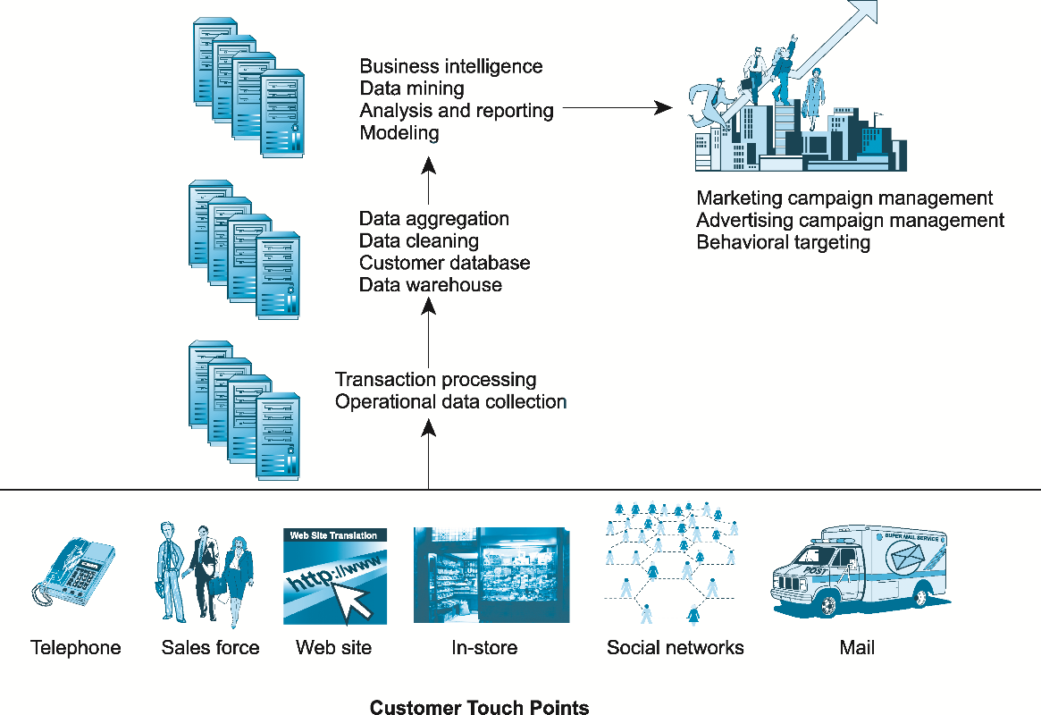
A CRM System
Figure 6.10, Page 387
Copyright © 2014 Pearson Education, Inc. Publishing as Prentice Hall
Slide 6-<number>

Slide 40
Online Marketing Metrics: Lexicon (Table 6.7)
Audience size or market share
  Impressions (# of times Ad is served)
  Click-through rate (CTR)
  View-through rate (VTR)
  Hits
  Page views
  Stickiness (duration)
  Unique visitors
  Loyalty
  Reach
  Recency
Conversion to customer
  Acquisition rate (visiting pgs)
  Conversion rate
  Browse-to-buy ratio
  View-to-cart ratio
  Cart conversion rate
  Checkout conversion rate
  Abandonment rate
  Retention rate
  Attrition rate
Copyright © 2014 Pearson Education, Inc. Publishing as Prentice Hall
Slide 6-<number>

Slide 41
Online Marketing Metrics (cont.)
Social marketing
  Conversation ratio
  Applause ratio (# likes/post)
  Amplification (retweets/post)
  Sentiment ratio (ratio of positive to total comments)
E-mail metrics
  Open rate
  Delivery rate
  Click-through rate
  (e-mail)
  Bounce-back rate
Copyright © 2014 Pearson Education, Inc. Publishing as Prentice Hall
Slide 6-<number>

Slide 42
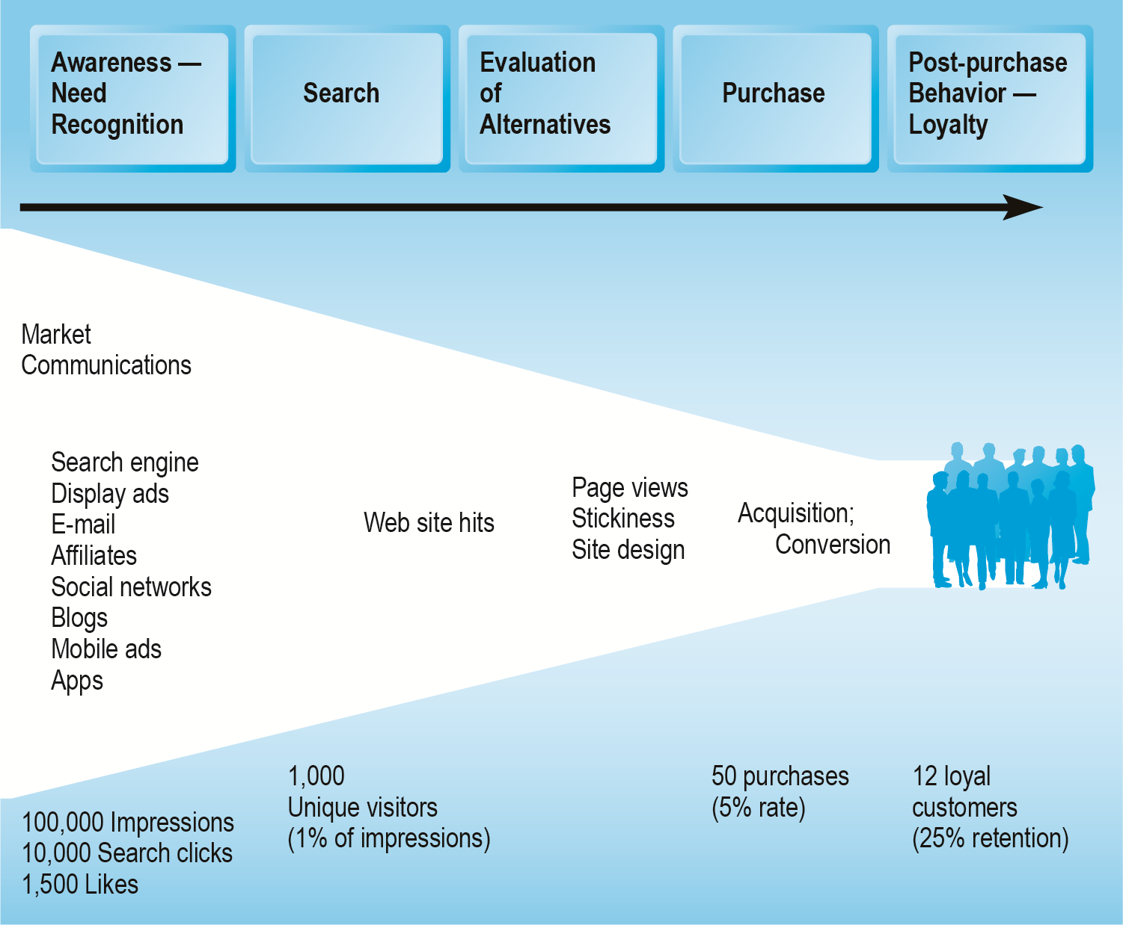
An Online Consumer Purchasing Model
Figure 6.11, Page 391
Copyright © 2014 Pearson Education, Inc. Publishing as Prentice Hall
Slide 6-<number>

Slide 43
How Well Does Online
Advertising Work?
Use ROI to measure ad campaign
Highest click-through rates: Search engine ads, permission e-mail campaigns
Rich media, video interaction rates high
Online channels compare favorably with traditional
Most powerful marketing campaigns use multiple channels, including online, catalog, TV, radio, newspapers, stores
Copyright © 2014 Pearson Education, Inc. Publishing as Prentice Hall
Slide 6-<number>

Slide 44
The Costs of Online Advertising
Pricing models
  Barter
  Cost per thousand (CPM)
  Cost per click (CPC)
  Cost per action (CPA)
Online revenues only
  Sales can be directly correlated
Both online/offline revenues
  Offline purchases cannot always be directly related to online campaign
In general, online marketing is more expensive on CPM basis, but more effective
Copyright © 2014 Pearson Education, Inc. Publishing as Prentice Hall
Slide 6-<number>

Slide 45
Web Analytics
Software that analyzes and presents data on each stage of the customer conversion process
  Awareness
  Engagement
  Interaction
  Purchase
  Loyalty and post-purchase
Helps managers
  Optimize ROI on Web site and marketing efforts
  Build detailed customer profiles
  Measure impact of marketing campaigns
Google Analytics, IBM Coremetrics, Adobe Analytics
Copyright © 2014 Pearson Education, Inc. Publishing as Prentice Hall
Slide 6-<number>

Slide 46
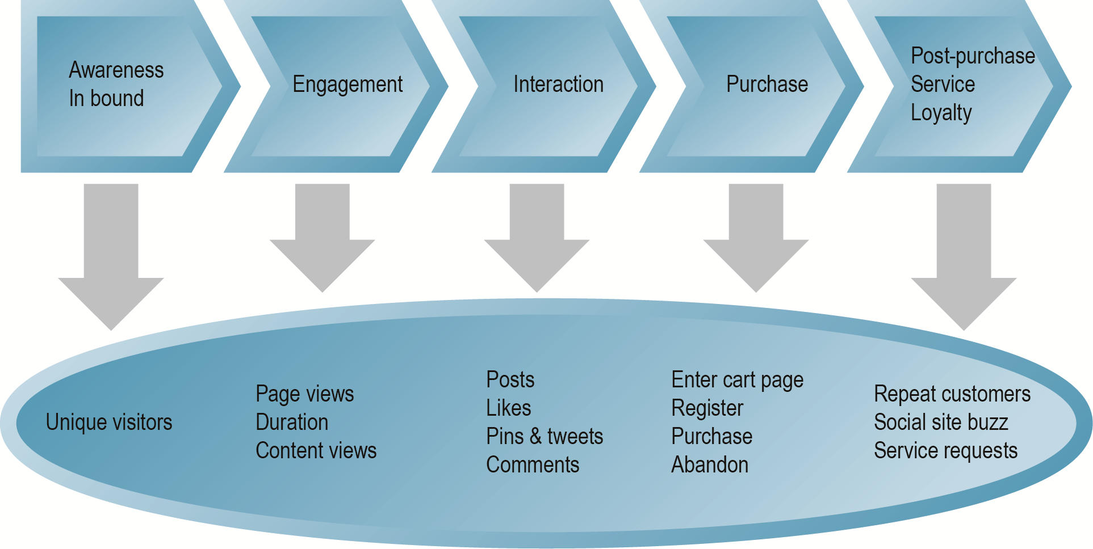
Web Analytics and the Online
Purchasing Process
Figure 6.12, Page 397
Copyright © 2014 Pearson Education, Inc. Publishing as Prentice Hall
Slide 6-<number>

